Slide 1

Operating System for Banking Systems
CSA0408- OPERATING SYSTEM
Guided By:
Dr. J. Vasavi
Presented by:
M. Pranay(192525382)

Slide 2


Introduction
Banking systems handle thousands of transactions simultaneously.
The OS provide:
Reliable transaction processing
Efficient resource management
Security and protection
Concurrent process execution
Fast input/output operations
A suitable OS architecture helps maintain performance, reliability, and security.

Slide 3
Objectives
Identify OS types suitable for banking systems.
Explain the OS structure used in transaction-based systems.
Understand the role of system calls in transaction processing.
Show how user applications communicate with the kernel.
Explain how the OS manages multiple transactions simultaneously.

Slide 4
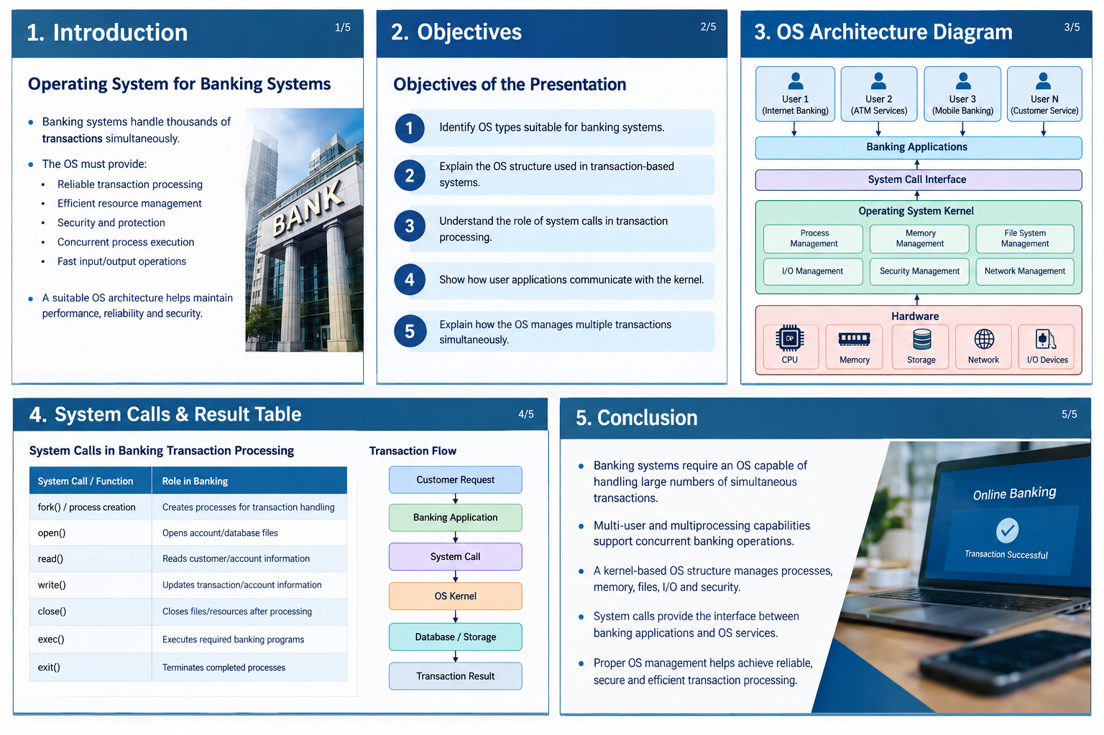
Architecture Diagram

Slide 5
System Calls

Slide 6
Conclusion
Banking systems require an OS capable of handling large numbers of simultaneous transactions.
Multi-user and multiprocessing capabilities support concurrent banking operations.
A kernel-based OS structure manages processes, memory, files, I/O, and security.
System calls provide the interface between banking applications and OS services.
Proper OS management helps achieve reliable, secure, and efficient transaction processing.

Slide 7
THANK YOU

Slide 8
